Slide 1
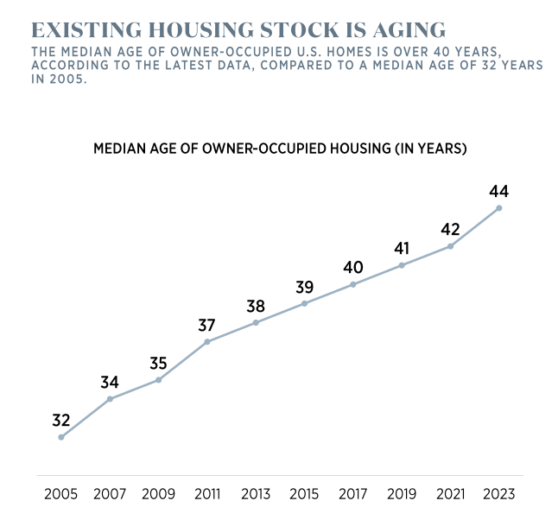
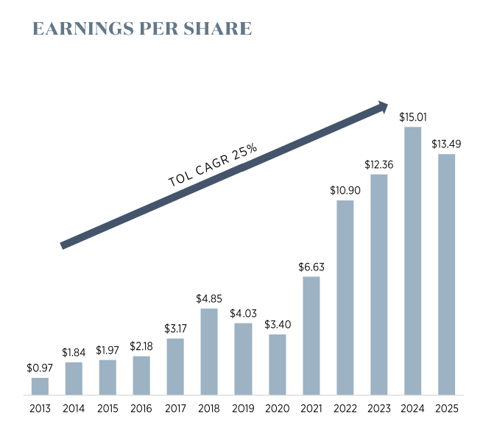
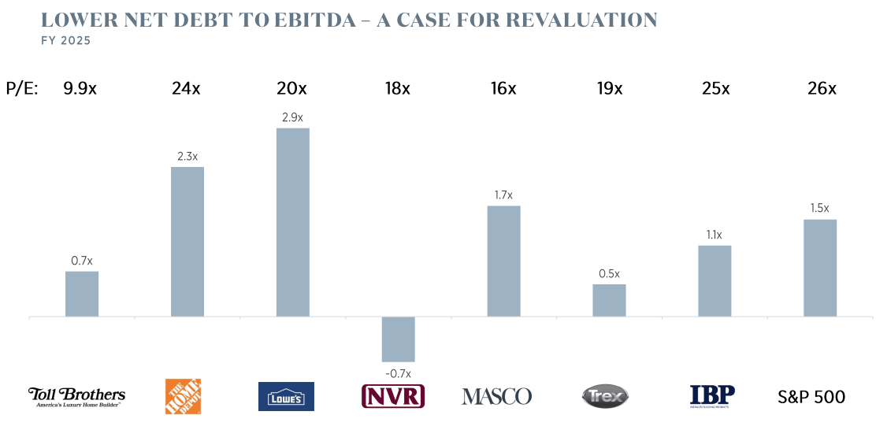
Toll Brothers Inc (NYSE: TOL)
Price: 137.04 MKT CAP: 13B Price Target: 178.67 Implied Upside: 31.6%
Executive Summary
Toll Brothers’ luxury-focus and affluent customer base and its strong financial position underpin its potential to outperform peers. Analysts and credit rating agencies note the company’s premium pricing power, resilient margins, low leverage, and disciplined capital allocation as key advantages. Thus, TOL is set for a long-term, Buy.
Industry Overview & Health
Company Overview
The U.S. homebuilding industry is currently facing moderate cyclical pressure, as affordability challenges driven by elevated home prices and mortgage rates continue to suppress buyer demand². Builders are also contending with rising material costs, labor shortages, and policy uncertainty, which are increasing construction costs and limiting new supply growth¹. Despite these headwinds, the sector remains supported by a persistent structural housing shortage and long-term demand drivers including demographic trends and an aging housing stock³. Industry sentiment reflects “cautious optimism,” with expectations that easing financial conditions and slightly lower mortgage rates could gradually improve sales and construction activity¹. Overall, while near-term conditions are constrained, the industry’s long-term fundamentals remain intact, supported by supply-demand imbalances and evolving housing needs¹.
Toll Brothers is a leading U.S. luxury homebuilder that designs, constructs, markets, and finances residential properties, primarily targeting affluent, move-up, and active-adult buyers in suburban and urban markets⁴. Founded in 1967 and headquartered in Pennsylvania, the company operates across 24 states and Washington, D.C., with a diversified portfolio that includes single-family homes, townhomes, high-rise condominiums, and rental apartments⁶. Its business is organized into segments such as Traditional Home Building and City Living, allowing it to serve both suburban luxury communities and urban infill developments⁴.
Toll Brothers also benefits from ancillary services including mortgage, insurance, and home automation, which enhance margins and customer integration⁶. Financially, the company generates over $10 billion in annual revenue and has maintained strong profitability, supported by high average selling prices and a focus on the premium housing segment⁵. Overall, Toll Brothers’ brand positioning in the luxury market, geographic diversification, and vertically integrated operations contribute to its status as one of the largest and most established homebuilders in the United States⁶.
Healthy Balance Sheet
Toll Brothers benefits from a very solid balance sheet and disciplined growth strategy. Fitch upgraded Toll’s credit rating in late 2025, citing its strong balance sheet and land-light strategy, with net debt around 17–18% of capitalization and EBITDA leverage near 1.3x.⁷ Management reports record deliveries and cash flow in FY2025 ($1.1B operating cash flow) and a $750M return to shareholders via buybacks/dividends.⁹ The company controls a large land pipeline (over 76,000 lots) yet has exited non-core multifamily projects, reflecting capital efficiency.⁹
CEO Yearley notes 8–10% planned growth in community count for FY2026 and emphasizes Toll’s “solid balance sheet, healthy liquidity and premier land holdings”⁹ as a platform for future growth. This financial strength and strategic discipline, including low leverage, ample liquidity, and share repurchases, position Toll Brothers to maintain profitability and grow.
9
9
Pricing Power
Toll Brothers’ emphasis on the high-end market segment gives it a notable competitive edge. Fitch Ratings highlights that Toll is the “leading public builder of luxury homes,” which yields one of the industry’s highest EBITDA margins.⁷ Its buyers tend to be affluent and well-capitalized – for example, about 26% of Toll’s buyers paid all cash and ~70% are move-up/down clients with substantial home equity, making them less sensitive to rate shocks.⁸ This translates into strong pricing power and low cancellation rates: Fitch explicitly notes Toll’s customers make large non-refundable deposits and have the lowest cancellation rates among peers.⁷ In short, Toll’s luxury-brand positioning and clientele provide resilience in a down cycle that many broader-market builders lack.
9
Sources: 1: National Association of Home Builders – 2026 Housing Outlook: Ongoing Challenges, Cautious Optimism and Incremental Gains, 2: National Association of Home Builders – Impact of Affordability Challenges and Demographic Shifts on Housing Trends in 2026, 3: National Association of Home Builders – Builders Identify Key Long-Term Forces Shaping Housing Demand and Industry Health, 4: Forbes – Toll Brothers Company Profile, 5: MacroTrends – Toll Brothers Revenue History, 6: Wikipedia – Toll Brothers Overview, 7: Fitch Ratings – Investing.com, 8: builderonline.com – Vincent Salandro, 9: Investors – tollbrothers.com,

Slide 2
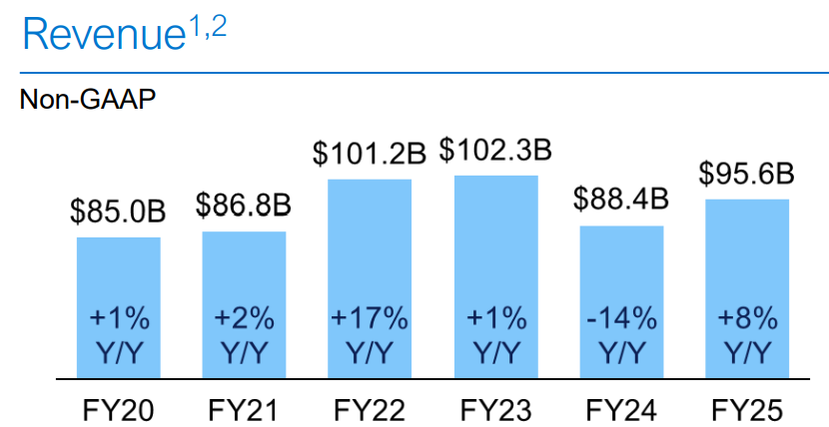
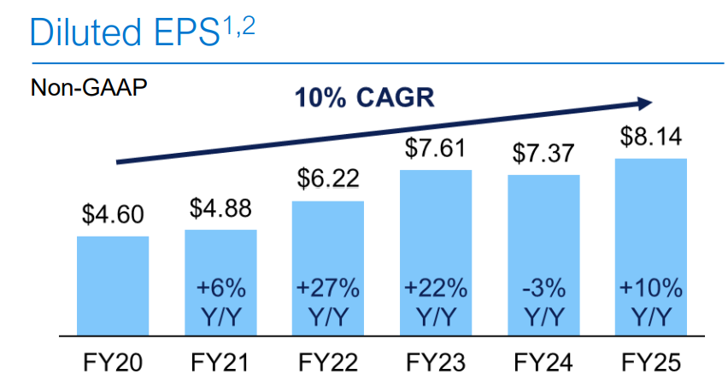
Dell Technologies (NYSE: DELL)
Price: 168.44 MKT CAP: 108.9B Price Target: 172 Implied Upside: 2.11%
Executive Summary
Dell is positioned to benefit from renewed demand as COVID-era desktops and laptops reach the end of their lifecycle. Also, with accelerating B2B partnerships and strong cash flow, supporting shareholder returns.
Industry Overview & Health
Company Overview
The technology industry—particularly in the hardware, software, and IT services sectors—forms a foundational pillar of the global digital economy, driving innovation and business transformation across multiple industries. This industry encompasses companies that design, manufacture, and integrate physical computing hardware, develop software applications and platforms, and provide critical IT services such as cloud computing, cybersecurity, and managed infrastructure that help organizations operate and modernize their technology environments⁵.
The hardware segment continues to evolve rapidly as demand grows for AI‑optimized servers, data center infrastructure, and next‑generation computing platforms that support emerging workloads⁴.
Meanwhile, the software market is expanding due to increased enterprise adoption of digital solutions, cloud‑native applications, and advanced analytics tools that improve efficiency and decision‑making⁶. The IT services sector is also growing robustly, with global spending on outsourced and cloud‑oriented services projected to rise significantly over the next decade as businesses accelerate digital transformation and seek flexible, scalable technology support⁷.
Dell Technologies offers a diverse range of quality products and services, with its ISG and CSG business units delivering solutions that serve customers from individual consumers to large enterprises¹. The company combines hardware, software, and services to meet a broad spectrum of technology needs, while Dell AI factories provide simplified and customized pathways for companies, both AI‑experienced and non‑experienced, to integrate AI into their operations².
In Q2 FY26, Dell generated $29.3 billion in revenue, with ISG contributing 57%, up 44% YoY from enterprise infrastructure, and CSG contributing 43%, up 1% YoY from commercial and consumer PCs³. To meet varying customer needs, Dell leverages multiple brands such as Alienware, Dell Pro, and OptiPlex, spanning applications from gaming to professional workstations⁴.
Revenue Cycles
The Covid Pandemic accelerated adoption of PCs and remote work setups as education and commerce were forced online.³
Average laptop life is ~4.5 years ¹ ; upcoming replacement cycle supports demand.
Huge spike in computer and accessory sales during early COVID compared to previous year(laptops +40%, keyboards +64%, headsets +134%, monitors +138%, webcams +179%).⁸ Furthermore, +75% of Dell's CSG Revenue is from Commercial PCs.⁶
⁹
Free Cash Flows
Dell’s strong, consistent free cash flow supports significant returns to shareholders. Dell sets an 80%+ target return of adj. FCF to shareholders through dividends and share repurchases^{6.} Also, adjusted free cash flow has averaged $4.5 B over last six years^{6.} Finally, Q1–Q2 FY26 stock repurchases increased ~105% and dividends increased ~17% compared to Q1-Q2 FY25, boosting shareholder value and returns.⁹
⁹
Dell is Investing into their Future, Driving B2B Demand:
In a fast-growing tech sector, Dell invests strategically in R&D and partnerships to expand its brand and product offerings for thriving companies. Dell has created strategic partnerships such as the Dell AI Factory with NVIDIA, Intel, and AMD⁶ ensuring Dell products and services are aligned with fast growing technological trends. In fact, ~ $649 M spent on average for past six quarters for capital expenditure⁹ ensuring products maintain competitive advantage.
Sources: 1: 1 www.businessinsider.com/guides/tech/how-long-do-laptops-last#:~:text=*%20An%20average%20laptop%20can%20last%20four,its%20performance%20and%20upgrading%20parts%20when%20possible, 2 finance.yahoo.com/quote/DELL/, 3 www.marketwatch.com/story/the-pandemic-pc-boom-gave-personal-computers-their-biggest-year-in-nearly-a-decade-11642013463, 4 www.nm.org/healthbeat/medical-advances/new-therapies-and-drug-trials/covid-19-pandemic-timeline, 5 www.nasdaq.com/articles/why-dell-technologies-stock-fell-48.7-in-november#:~:text=What%20happened,Image%20source:%20Getty%20Images, 6 investors.delltechnologies.com/why-invest, 7 companiesmarketcap.com/dell/marketcap/, 8 finance.yahoo.com, 9 investors.delltechnologies.com

Slide 3
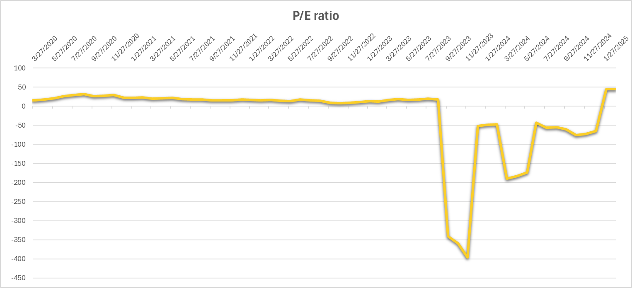
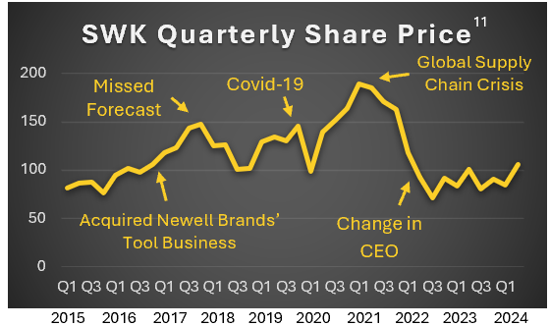
Stanley Black & Decker (NYSE: SWK)
Price: 71.11 MKT CAP: 11B Price Target: 90.73 Implied Upside: 27.59%
Executive Summary
Investors appear slow to trust SWK’s transformation efforts despite actual performance improvements. This, combined with strong fundamental demand, highlights an early and bargain-priced, long-term BUY opportunity.
Industry Overview & Health
Company Overview
The industrials sector—especially tools & accessories and engineered fastening systems—remains in solid health, supported by construction and manufacturing demand, though still cyclical and rate-sensitive.¹ Growth is driven by infrastructure spending, reshoring, and electrification, alongside innovation in cordless tools and automation, which boost demand and margins. Tools benefit from recurring aftermarket sales, while fastening systems gain stability from OEM integration and long-term secular trends. Recent risks include softening global demand, inventory destocking, and persistent interest rate pressure, which may weigh on near-term volumes.
Stanley Black & Decker, a leading tool company with well-known brands like DEWALT,² offers a clear path for growth supported by strong fundamental demand across residential, commercial, and global infrastructure and agriculture sectors. The U.S. faces a housing shortage of 3.8 million homes⁶, while the median housing stock age of 44 years⁵ drives repair and remodel work, and an estimated $97 trillion in global infrastructure investment by 2040³ highlights the large market opportunity.
The company’s products are innovative and award-winning, focused on efficiency, safety, and electrification trends. Stanley Black & Decker issues over 1,000 patents annually¹⁴, won 10 Red Dot Awards in 2024¹³, and received five Popular Mechanics Tool Awards in 2025¹², including its Best Performing Line, reinforcing its leadership in both product design and market relevance.
Supply Chain Recovery
Causes of supply chain disruptions and working capital challenges are in the past. COVID had many impacts on the world with dramatically increased costs of inventory and delivery delays. Yet, 2023 inventory reduction of approx. 29% from Q2 2022 peak.⁴ Even during the 2021 gross inventory expansion, revenue and operating profit expanded.⁴ Aggressive goals on supply chain savings are continually progressing today.⁴
¹⁰
Negative P/E Driven by non-operating expenses
Strategic Positioning
Management re-alignment and re-focusing has occurred. Leaders such as the CEO appointed in 2022, executed a company transformation. Refreshed leaders also include the CRHO in 2024, the CFO & COO, who is now the acting CEO, in 2023; the CSCO in 2022. Significant acquisition and divestment as part of commitment to simplify and streamline the business has occurred.⁴ Overall, the commitment to innovation, cost control, and cash flow were emphasized in the annual report⁴
SWK is also “investing $30M over five years to fund vocational training and reskilling in construction, aiming to close the trade skills gap and strengthen the industry,” ⁸ with 70 reward recipients in 2024.⁷
Free cash flow is now positive. ‘23’s net income loss primarily related to business restructuring costs and non-cash asset impairments, not to the operations. ‘24’s net income loss stems from non-cash environmental charges and restructuring charges. Furthermore, SWK has had an uninterrupted dividend for decades⁹
Sources: ¹YahooFinance.com as of March 28, 2025; ²https://www.marketscreener.com/quote/stock/STANLEY-BLACK-DECKER-INC-14522/consensus/; ³Global Infrastructure Hub’s Global Infrastructure Outlook Infrastructure investment needs 56 countries, 7 sectors to 2040; ⁴SWK SEC 10-K and 10-Q Filings 2023, 2022, and 2021; ⁵https://www.thisoldhouse.com/moving/median-age-of-a-house; ⁶https://www.freddiemac.com/research/forecast/20241126-us-economy-remains-resilient-with-strong-q3-growth#:~:text=In%20our%20last%20published%20estimate,slightly%20to%203.7%20million%20un; ⁷https://www.stanleyblackanddecker.com/impact/people/grow-the-trades/grant-recipients; ⁸https://www.stanleyblackanddecker.com/impact/people/grow-the-trades; ⁹www.Nasdaq.com/market-activity/stock/swk/dividend-history; ¹⁰https://public.com/stocks/swk/pe-ratio?wpsrc=Organic+Search&wpsn=www.google.com; ¹¹https://macrotrends.net/?q=swk+; ¹²https://www.stanleyblackanddecker.com/news-stories/stories/dive-innovation-explore-our-popular-mechanics-tool-award-winners; ¹³https://www.stanleyblackanddecker.com/news-stories/stories/winning-big-red-dot-awards; ¹⁴https://www.stanleyblackanddecker.com/brands/industrial/engineered-fastening; ¹⁵https://newsroom.stanleyblackanddecker.com/2024-06-17-DEWALT-Introduces-XR-POWERPACK-TM-Tabless-Cell-Battery-Within-Next-Generation-XR-R-Portfolio-Establishing-its-Best-Performing-Line-Of-20V-MAX-Batteries-and-Power-Tools

Slide 4
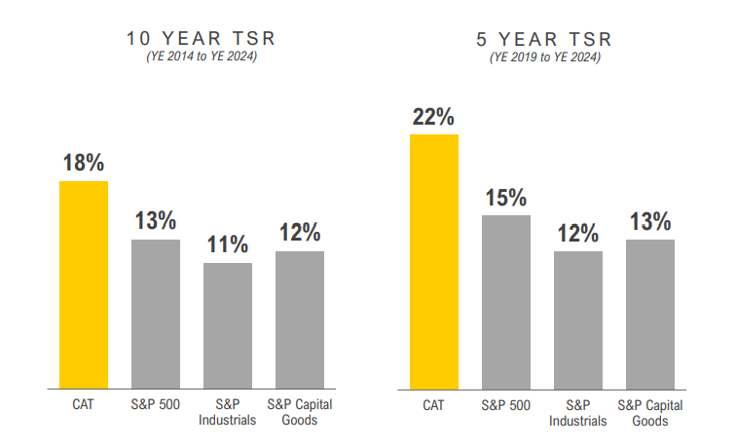
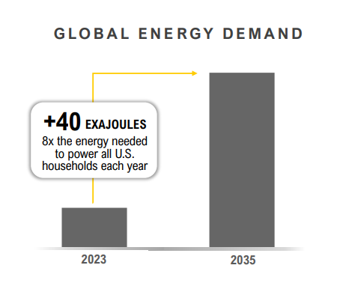
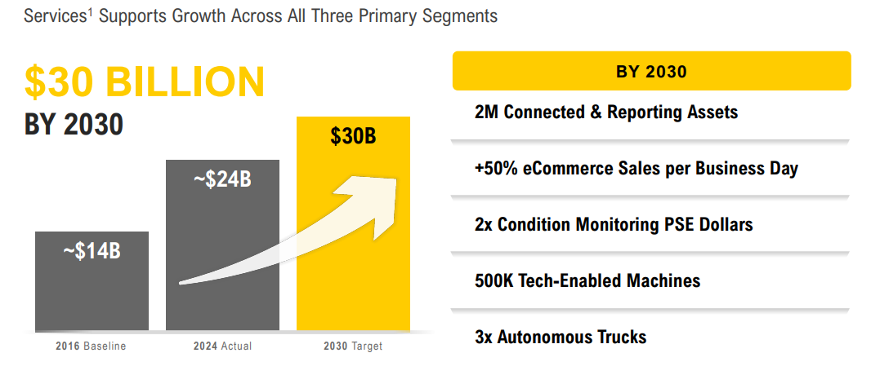
Caterpillar (NYSE: CAT)
Price: 722 MKT CAP: 342B Price Target: 737.55 Implied Upside: 2.15%
Executive Summary
Caterpillar is a leader in industrial machinery, strategically positioned in essential sectors like construction, mining, and energy. By focusing on high-margin services and parts alongside its global reach, the company drives recurring revenue, strengthens customer loyalty, and maintains resilience against market cycles.
Industry Overview & Health
Company Overview
The industrial machinery sector includes manufacturers of construction and mining equipment, diesel and natural gas engines, industrial gas turbines, and diesel‑electric locomotives that supply essential heavy machinery and power solutions used in infrastructure, mining, and transportation globally¹. Demand in this sector is supported by growth in construction, mining, and industrial engine applications, with the industrial engine market expanding as heavy‑duty machinery continues to be deployed in infrastructure projects and mechanized operations². Diesel and industrial engines remain central to heavy equipment due to their durability, high torque output, and reliability in demanding environments, and manufacturers are increasingly investing in advanced engine technologies, hybrid systems, and innovations to meet evolving performance and emission standards³.
Caterpillar Inc. is the world’s leading manufacturer of construction and mining equipment, off‑highway diesel and natural gas engines, industrial gas turbines, and diesel‑electric locomotives, serving critical sectors such as infrastructure, mining, energy, and transportation⁴. Founded in 1925 and headquartered in Irving, Texas, Caterpillar’s diversified product portfolio and extensive global dealer network help it reach customers in nearly every region of the world, enhancing its competitive reach and customer support capabilities⁴. The company drives growth through a commitment to commercial excellence, advanced technology, and operational excellence, supported by strong customer partnerships and a focus on solving complex industrial challenges⁵.
Strategically, Caterpillar’s emphasis on technology integration—such as digital solutions, connectivity, and automation—positions it to improve productivity and efficiency for customers, aligning with trends toward smarter, more sustainable operations⁵. Its broad presence across essential industries and its focus on innovation give it resilience against cyclical downturns and competitive pressures, enabling the company to adapt and expand into new markets while maintaining leadership in traditional heavy machinery and power systems⁾⁶.
13
Positive Revenue Outlook
Caterpillar is mitigating market volatility by expanding its high-margin services and aftermarket business, which transforms the company from a one-time equipment seller into a long-term service provider. Instead of just selling a bulldozer and walking away, Caterpillar now focuses on "aftermarket" revenue—the high-profit sales of replacement parts, digital monitoring, and maintenance contracts required to keep that machine running for its 10-to-20-year lifespan.⁷ By using sensors on 4 million machines to predict failures before they happen, they grew service revenue to $24 billion in 2025 and aim for $30 billion by 2030; these services are "high-margin" because software and spare parts yield much higher profits than the initial sale of a heavy machine.⁸ This strategy creates a "revenue boost" that acts as an "earnings floor," because even if a construction company stops buying new fleet during a recession, they must still pay for the parts and repairs provided by Caterpillar to keep their existing machines operational.⁹
Tariff Mitigation
Caterpillar is actively managing significant cost pressures through strategic pricing and a shifting legal landscape. Although the company faced a $1.7 billion net incremental tariff headwind in 2025, which contributed to an operating margin compression from 18.0% to 13.9% in Q4, it has implemented disciplined pricing actions to protect its profitability.¹⁰
A landmark February 2026 Supreme Court ruling, which limited the executive branch's power to unilaterally impose industrial tariffs, has significantly brightened the outlook by potentially reducing the $2.6 billion in tariff hits projected for the current year.¹¹Combined with a record-breaking $51.2 billion order backlog, a 71% year-over-year increase, these cost-mitigation efforts and judicial reliefs allow Caterpillar to project 2026 revenue growth at the top of its 5% to 7% long-term target range.¹²
13
13
Sources: 1: Top 10 Machinery Manufacturers, 2: Industrial Engine Market Size & Share and heavy‑duty applications, 3: Diesel Industrial Engine Market Trends Report, 4: Caterpillar at a Glance (caterpillar.com), 5: Caterpillar’s Strategy & Purpose (caterpillar.com), 6: Caterpillar SWOT Analysis & Strategic Plan 2025‑Q3 (swotanalysis.com), 7: Caterpillar Investor Relations (Services Growth Strategy), 8: Investing.com (Q4 2025 Earnings Analysis), 9: The Motley Fool (Caterpillar Aftermarket Review), 10: Caterpillar Inc. (Official 2025 Financial Results), 11: Holland & Knight / MarketMinute (Legal Update), 12: Zacks Investment Research (April 2026 Analyst Update), 13: investors.caterpillar.com

